Slide 1
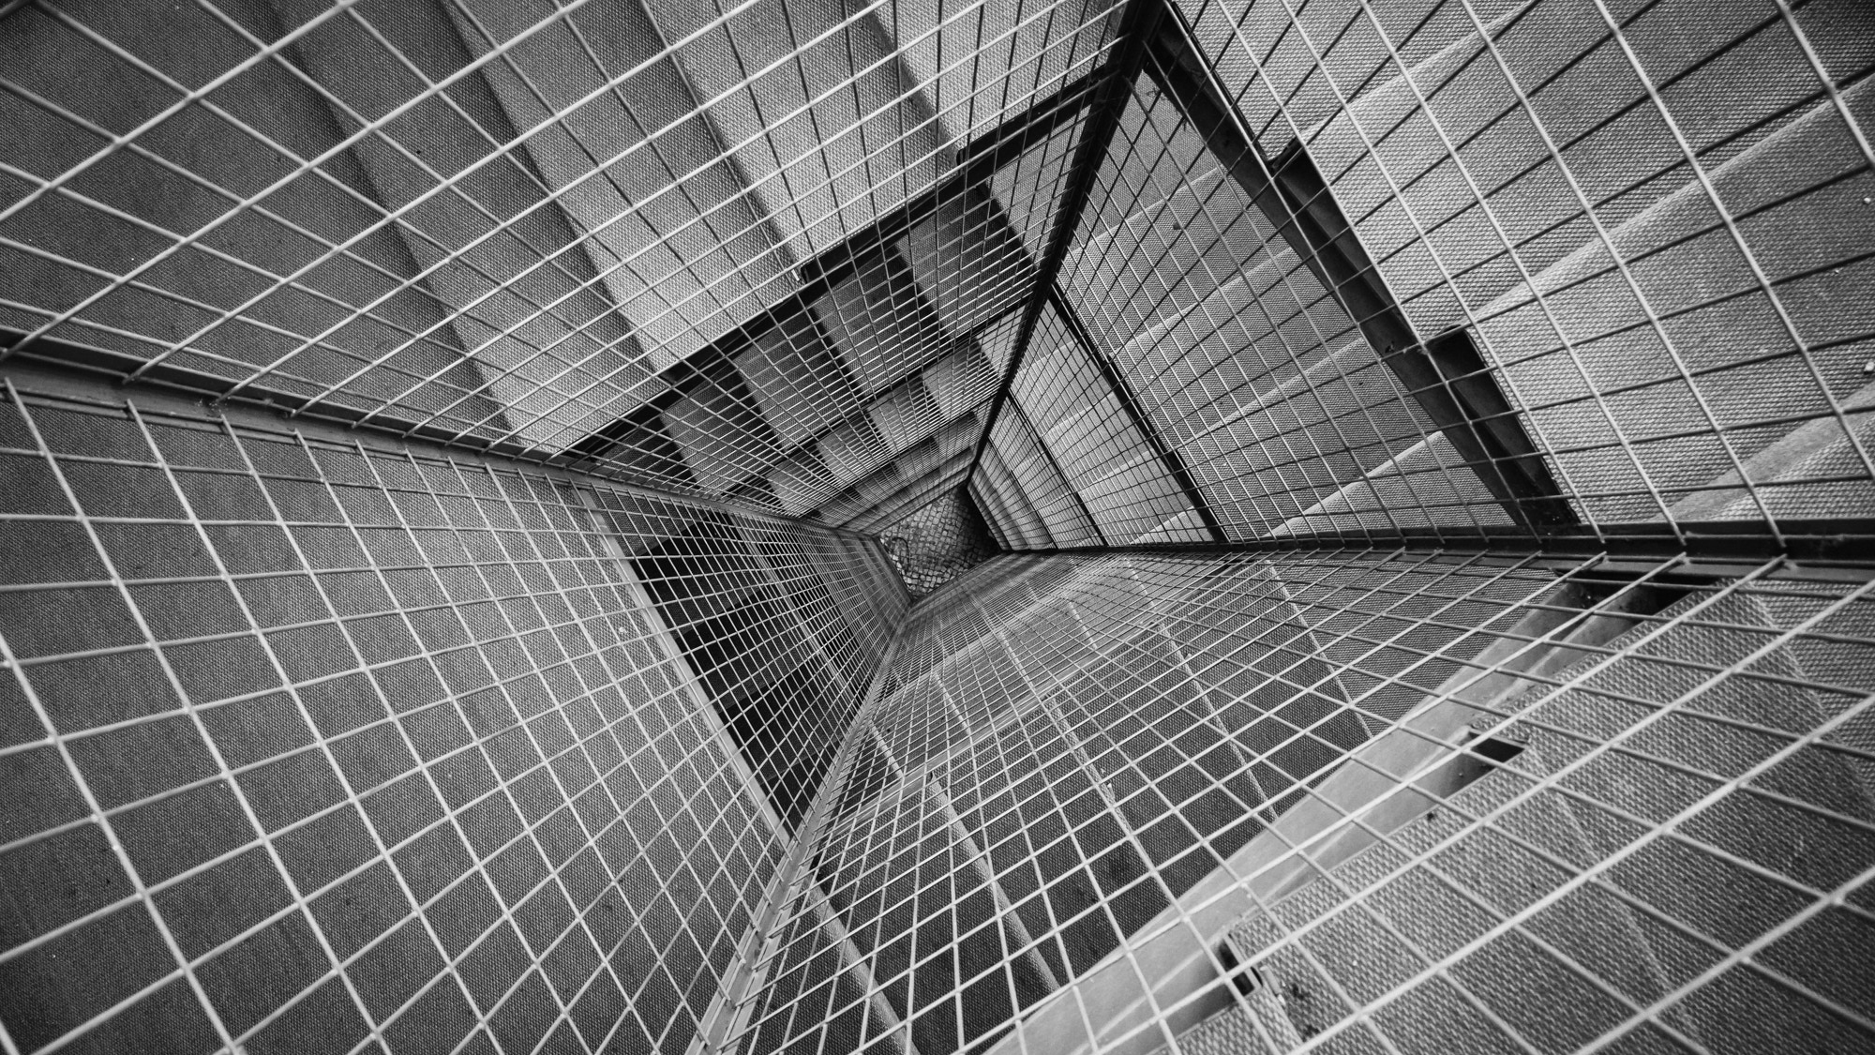
TOTAL TECHNOLOGY
REPORTLAB COMPLETE TUTORIAL
Sequence in paragraph
Part 24

Slide 2
How to add sequence in paragraph
ReportLab supports sequence numbering .
We can easily insert section number, paragraph numbers or some other type of number to our document.
This is done using the sequence tag: <seq>
TOTAL TECHNOLOGY

Slide 3
How to add sequence number for paragraph
from reportlab.platypus import Paragraph,SimpleDocTemplate,Spacer
from reportlab.lib.styles import getSampleStyleSheet
pdf=SimpleDocTemplate("tutorial24.pdf")
flow_obj=[]
styles=getSampleStyleSheet()
for i in range(4):
p_seq='<seq id="section-id"/>.section'
p_seq_text=Paragraph(p_seq,style=styles["Normal"])
flow_obj.append(p_seq_text)
flow_obj.append(Spacer(1,35))
pdf.build(flow_obj)
TOTAL TECHNOLOGY

Slide 4
How to create paragraph with sequence number
from reportlab.platypus import Paragraph,SimpleDocTemplate,Spacer
from reportlab.lib.styles import getSampleStyleSheet
pdf=SimpleDocTemplate("tutorial24.pdf")
flow_obj=[]
styles=getSampleStyleSheet()
for i in range(1,5):
p_seq='<seq id="section-id"/>.section'
p_seq_text=Paragraph(p_seq,style=styles["Normal"])
flow_obj.append(p_seq_text)
flow_obj.append(Spacer(1,15))
p_con='content %s'% i
p_con_text=Paragraph(p_con,style=styles["Normal"])
flow_obj.append(p_con_text)
flow_obj.append(Spacer(1,45))
pdf.build(flow_obj)
TOTAL TECHNOLOGY

Slide 5
How to create paragraph and sequence number with custom font ,size and color
from reportlab.platypus import Paragraph,SimpleDocTemplate,Spacer
from reportlab.lib.styles import getSampleStyleSheet
pdf=SimpleDocTemplate("tutorial24.pdf")
flow_obj=[]
styles=getSampleStyleSheet()
for i in range(11,15):
p_seq='<font name=Times-Italic size=20 color=red><seq id="section-id"/>.section</font>'
p_seq_text=Paragraph(p_seq,style=styles["Normal"])
flow_obj.append(p_seq_text)
flow_obj.append(Spacer(1,15))
p_con='<font name=Helvetica size=15 color=green>content %s</font>'% i
p_con_text=Paragraph(p_con,style=styles["Normal"])
flow_obj.append(p_con_text)
flow_obj.append(Spacer(1,45))
pdf.build(flow_obj)
TOTAL TECHNOLOGY

